Slide 1
Acceptability Judgements on
Contrastive Dialogues
Involving ellipsis
Master’s thesis
Supervisors:
Prof. Dr. Michael Franke
Jun.-Prof. Dr. James Griffiths
Miriam Schiele
25 September 2023

Slide 2
Research question & hypotheses
Study design
Results
Discussion
Fragment theory
Participants
Conclusions
The Influence of Metaphors
Contrastive Dialogues involving ellipsis

Slide 3
Fragment Theory
A: Mary stole the cookie.
B: No, Peter.

Slide 4
Fragment Theory
A: Mary stole the cookie.
B: No, Peter stole the cookie.

Slide 5
Fragment Theory
A: Mary stole the cookie.
B: No, Peter stole the cookie.
Fragment
remnant of ellipsis
Griffiths et al., 2023

Slide 6
Fragment Theory
A: Mary stole the cookie.
B: No, [Peter]_{F}
Contrastive focus F
given alternative element for which the predicate actually holds
must bear pitch accent
Griffiths & Lipták, 2014; Krifka, 2008; Winkler, 2019

Slide 7
Fragment Theory
A: Mary stole the cookie.
B: No, Peter.
assign category to remnant
find correlate in antecedent clause
construct elided phrase
Harris & Carlson, 2018

Slide 8
Fragment Theory
A: Mary stole the cookie.
B: No, Peter_{DP=Remnant}
assign category to remnant
find correlate in antecedent clause
construct elided phrase
Harris & Carlson, 2018

Slide 9
Fragment Theory
A: Mary_{DP=Correlate} stole the cookie.
B: No, Peter_{DP=Remnant}
assign category to remnant
find correlate in antecedent clause
construct elided phrase
Harris & Carlson, 2018

Slide 10
Fragment Theory
A: Mary_{DP=Correlate} stole the cookie.
B: No, Peter_{DP=Remnant} stole the cookie.
assign category to remnant
find correlate in antecedent clause
construct elided phrase
Harris & Carlson, 2018

Slide 11
Research Question
What is the most effective medium for obtaining acceptability judgements about dialogues involving contrastive focus?
similar input with more effort:
crane neck / sit up

Slide 12
Hypotheses
Modality
Emphasis
Fragment type

Slide 13

Hypotheses
Modality
A: Peter showed his identity card to the police officer.
B: No, the bouncer.
written
auditory

Slide 14
Hypotheses
Modality
written
fragments are less common in written language
auditory
fragments are more common in spoken language
Akinnaso, 1982

Slide 15
Hypotheses
Modality auditory > written
Fragment type
lexical fragments > functional fragments
Emphasis
emphasis on contrasting words > lacking emphasis

Slide 16
Hypotheses
Emphasis
A: Peter showed his identity card to the POLICE OFFICER.
B: No, the BOUNCER.
with emphasis
without emphasis
A: Peter showed his identity card to the police officer.
B: No, the bouncer.

Slide 17
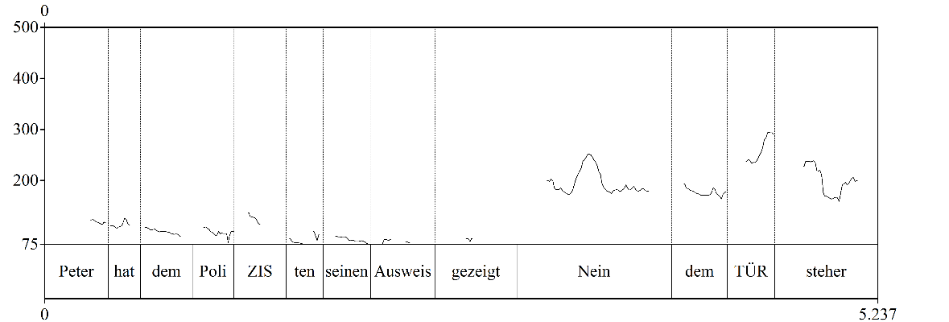
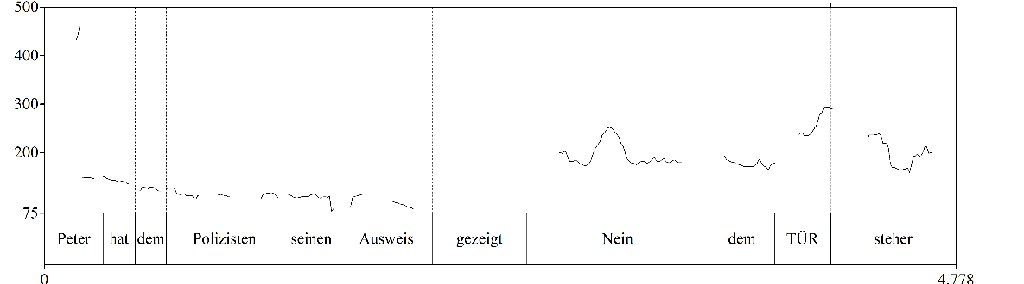
Hypotheses
Emphasis
with emphasis
without emphasis

Slide 18
Hypotheses
Emphasis
with emphasis
easier to identify correlate-remnant pairing
without emphasis
more difficult to identity correlate-remnant pairing
Carlson et al., 2009

Slide 19
Hypotheses
Modality auditory > written
Fragment type
lexical fragments > functional fragments
Emphasis
emphasis on contrasting words > lacking emphasis

Slide 20
Hypotheses
Fragment type
lexical
A: Peter showed his identity card to the POLICE OFFICER.
B: No, the BOUNCER.
functional
A: Peter worked at the cinema FROM 6pm.
B: No, UNTIL 6pm.

Slide 21
Hypotheses
Fragment type
lexical
bear stress
more focussed on in reading
functional
do not bear stress
less focussed on in reading
Roussel et al., 2018; Chomsky & Halle, 1991; Féry & Herbst, 2004

Slide 22
Hypotheses
Modality auditory > written
Fragment type
lexical fragments > functional fragments
Emphasis
emphasis on contrasting words > lacking emphasis

Slide 23
Study design
Modality
written
Emphasis
with
Fragment type
lexical
functional
auditory
without

Slide 24
Study design
Modality
written
Emphasis
with
Fragment type
lexical
functional
auditory
without
between-subject
within-subject

Slide 25
Study design
Acceptability Judgement Task
rate naturalness of speaker B’s answer
7-point Likert scale
forced choice
no time limit

Slide 26
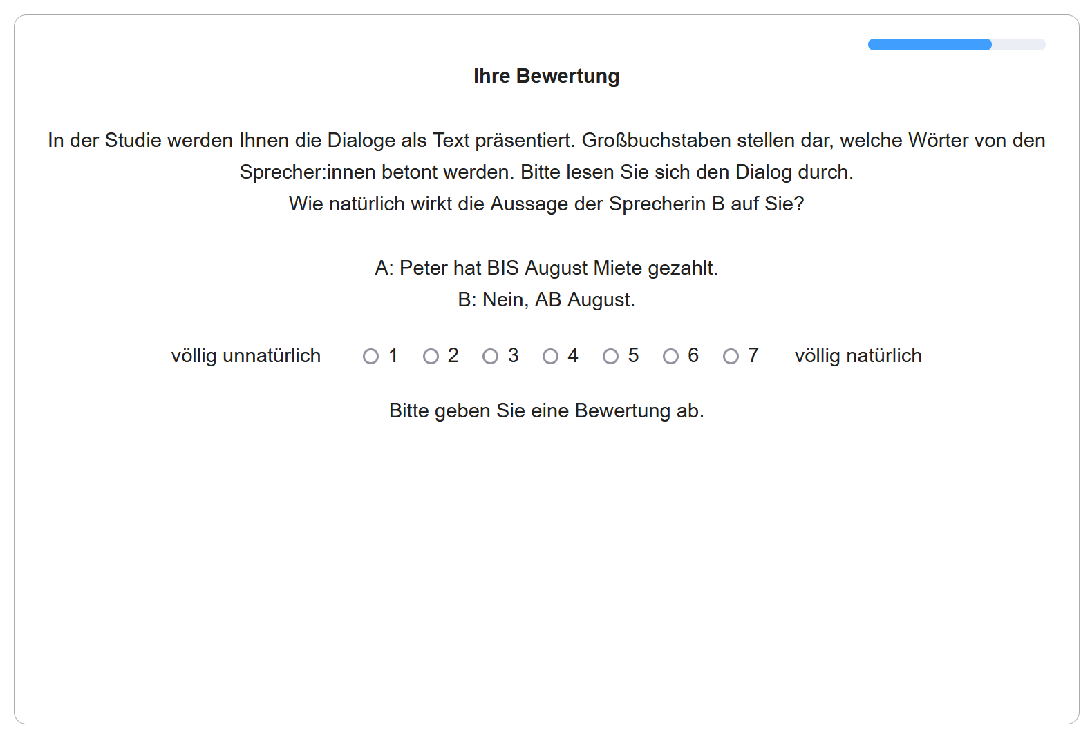
Study design
Acceptability Judgement Task
rate naturalness of speaker B’s answer
7-point Likert scale
forced choice
no time limit

Slide 27
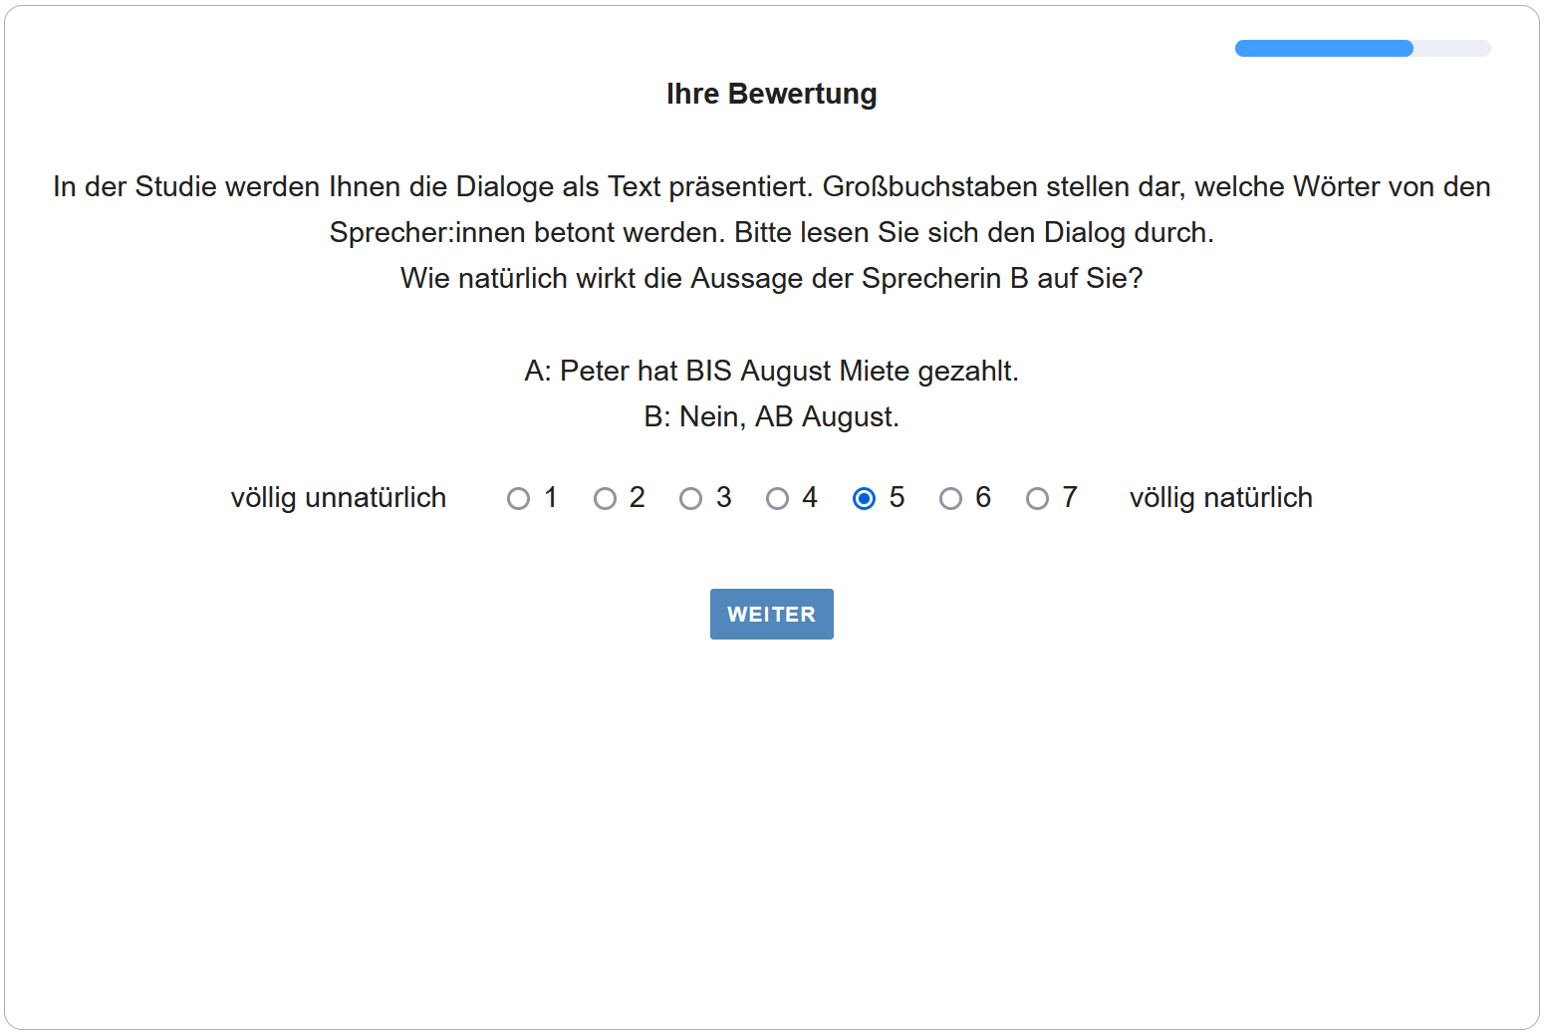
Study design
Acceptability Judgement Task
rate naturalness of speaker B’s answer
7-point Likert scale
forced choice
no time limit

Slide 28

Participants
n = 100
German native speakers
age between 19-73 years (m = 35.5)
69 males, 29 females, 2 diverse
crowdsourced from Prolific

Slide 29
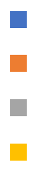
Participants’ highest degree
9
without high school diploma
35
completed high school
with bachelor’s degree
29
with higher degree
27

Slide 30
Results

Slide 31
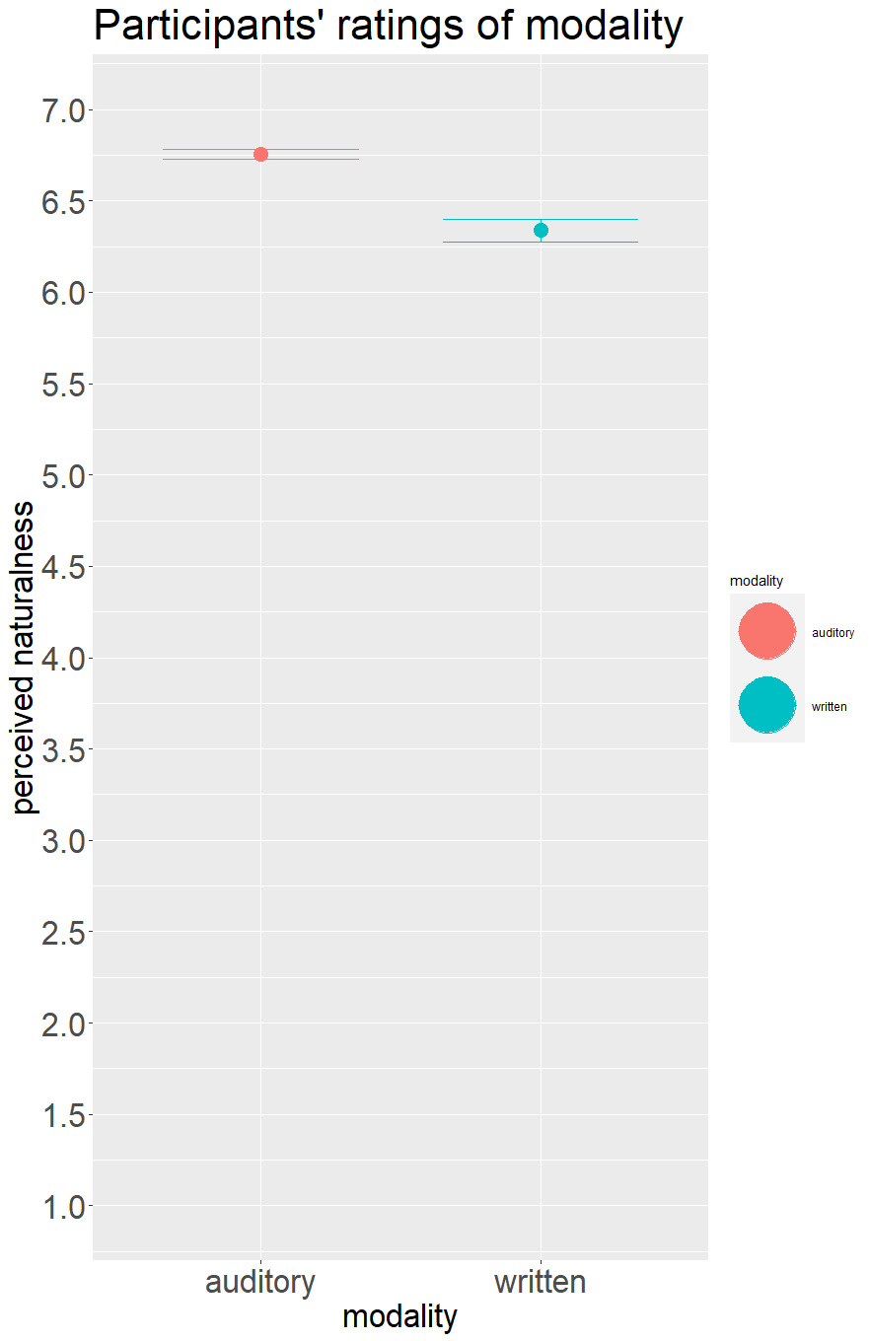
Results
Modality
auditory: m = 6.76, sd = 0.53
written: m = 6.34, sd = 1.11

Slide 32
Results
Modality
written: β₁ = -1.99
as hypothesised
significant effect: p = 0.016

Slide 33
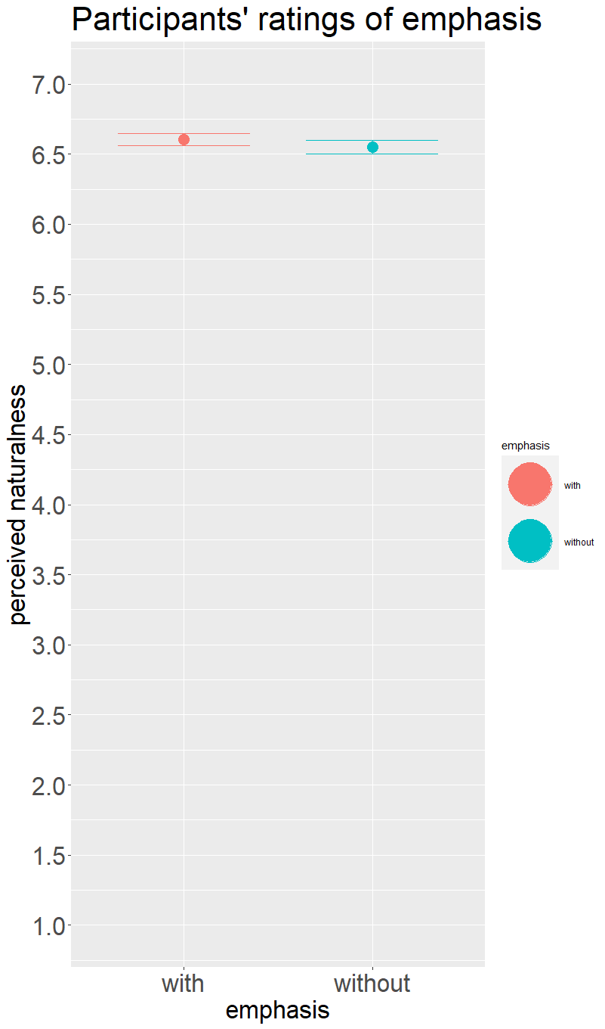
Results
Emphasis
with emphasis: m = 6.60, sd = 0.80
without emphasis: m = 6.55, sd = 0.91

Slide 34
Results
Emphasis
without: β₁ = -0.25
as hypothesised
significant effect: p = 0.027

Slide 35
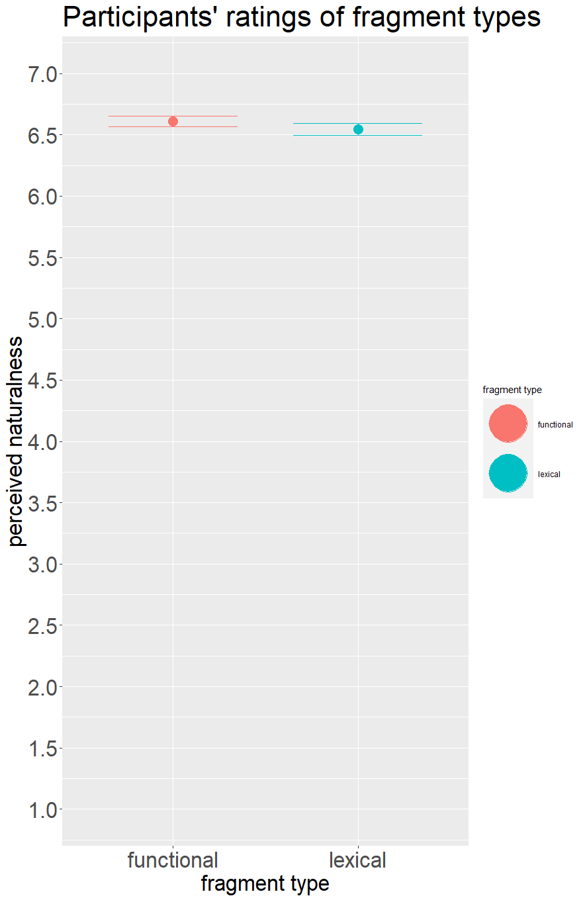
Results
Fragment type
functional: m = 6.61, sd = 0.82
lexical: m = 6.55, sd = 0.90

Slide 36
Results
Fragment type
lexical: β₁ = -0.49
inverse to hypothesis
significantly effect: p < 0.01

Slide 37
Results
Fragment type
Potential explanation for inverse trend?

Slide 38
Inverse Trend
functional
lexical
A: Peter worked at the cinema FROM 6pm.
B: No, UNTIL 6pm.
A: Peter showed his identity card to the POLICE OFFICER.
B: No, the BOUNCER.

Slide 39
Inverse Trend
functional
lexical
A: Peter worked at the cinema FROM 6pm.
B: No, UNTIL 6pm.
A: Peter showed his identity card to the POLICE OFFICER.
B: No, the BOUNCER.
prepositions have opposing meaning:
binary contrast

Slide 40
Inverse Trend
functional
lexical
A: Peter worked at the cinema FROM 6pm.
B: No, UNTIL 6pm.
A: Peter showed his identity card to the POLICE OFFICER.
B: No, the BOUNCER.
prepositions have opposing meaning:
binary contrast
nouns denote alternative referents:
non-binary contrast

Slide 41
Inverse Trend
prepositions have opposing meaning:
binary contrast
nouns denote alternative referents:
non-binary contrast

Slide 42
Inverse Trend
prepositions have opposing meaning:
binary contrast
nouns denote alternative referents:
non-binary contrast
The clearer the contrast, the more natural the dialogue?

Slide 43
Conclusions

Slide 44
Conclusions
accepted hypo-theses
emphasis and modality affect judgements on con-trastive fragments

Slide 45
Conclusions
accepted hypo-theses
emphasis and modality affect judgements on con-trastive fragments
inverse trend
functional fragments rated more natural
perhaps due to clearer contrast?

Slide 46
Conclusions
accepted hypo-theses
emphasis and modality affect judgements on con-trastive fragments
inverse trend
functional fragments rated more natural
perhaps due to clearer contrast?
further research
influence of clarity of contrast
compare phrasal answers to one-word answers

Slide 47
Thank you for listening!

Slide 48

Discussion

Slide 49
References
Akinnaso, F. N. (1982). On The Differences Between Spoken and Written Language. Language and Speech, 25(2), 97–125. https://doi.org/10.1177/002383098202500201
Baayen, R. H., Davidson, D. J., & Bates, D. M. (2008). Mixed-effects modeling with crossed random effects for subjects and items. Journal of Memory and Language, 59(4), 390–412. https://doi.org/10.1016/j.jml.2007.12.005
Beckman, M. E., & Ayers. (1997). Guidelines for ToBI labelling, version 3. The Ohio State University Research Foundation. http://www.ling.ohio-state.edu/phonetics/ToBI/ToBI.0.html
Biber, D., Johansson, S., Leech, G. N., Conrad, S., & Finegan, E. (2021). Grammar of Spoken and Written English. John Benjamins Publishing Company. https://doi.org/10.1075/z.232
Black, M., Coltheart, M., & Byng, S. (1985). Forms of coding in sentence comprehension during reading. In M. Coltheart (Ed.), Attention and performance XII: The psychology of reading (pp. 655–672). Lawrence Erlbaum Associates.
Carlson, K., Frazier, L., & Clifton, C. (2009). How prosody constrains comprehension: A limited effect of prosodic packaging. Lingua, 119(7), 1066–1082. https://doi.org/10.1016/j.lingua.2008.11.003

Slide 50
References
Chomsky, N. (1957). Syntactic Structures. Mouton de Gruyter.
Chomsky, N., & Halle, M. (1991). The sound pattern of English (1st MIT Press paperback. ed). MIT Press.
Christensen, R. H. B. (2018). Regression Models for Ordinal Data: Introducing R-package ordinal [Computer software]. https://cran.r-project.org/package=ordinal
Curtis, A., Smith, T., Ziganshin, B., & Elefteriades, J. (2016). The Mystery of the Z-Score. AORTA, 4(4), 124–130. https://doi.org/10.12945/j.aorta.2016.16.014
Delbar, N. A. (2019). Swiping in English and Dutch: The Interaction between R-Pronouns and Modal Particles.
Featherston, S. (2008). Thermometer judgements as linguistic evidence. In C. M. Riehl & A. Rothe (Eds.), Was ist linguistische Evidenz? Shaker Verlag.
Féry, C. (2011). German sentence accents and embedded prosodic phrases. Lingua, 121(13), 1906–1922. https://doi.org/10.1016/j.lingua.2011.07.005
Féry, C., & Herbst, L. (2004). German Sentence Accent Revisited. Interdisciplinary Studies in Information Structures 1. Working Pa-Pers of the SFB 632, 43–75.

Slide 51
References
Franck, J., Bowers, J., Frauenfelder, U. H., & Vigliocco, G. (2003). Orthographic influences on agreement: A case for modality-specific form effects on grammatical encoding. Language and Cognitive Processes, 18(1), 61–79. https://doi.org/10.1080/01690960143000452
Frazier, L., & Clifton, C. (1998). Comprehension of Sluiced Sentences. Language and Cognitive Processes, 13(4), 499–520. https://doi.org/10.1080/016909698386474
Frazier, L., Taft, L., Roeper, T., Clifton, C., & Ehrlich, K. (1984). Parallel structure: A source of facilitation in sentence comprehension. Memory & Cognition, 12(5), 421–430. https://doi.org/10.3758/BF03198303
Griffiths, J., Güneş, G., & Lipták, A. (2023). Reprise fragments in English and Hungarian: Further support for an in-situ Q-equivalence approach to clausal ellipsis. Language, 99(1), 154–191. https://doi.org/10.1353/lan.2023.0000
Griffiths, J., & Lipták, A. (2014). Contrast and Island Sensitivity in Clausal Ellipsis. Syntax, 17(3), 189–234. https://doi.org/10.1111/synt.12018
Harris, J. A. (2015). Structure Modulates Similarity-Based Interference in Sluicing: An Eye Tracking study. Frontiers in Psychology, 6. https://doi.org/10.3389/fpsyg.2015.01839

Slide 52
References
Harris, J. A., & Carlson, K. (2016). Keep it local (and final): Remnant preferences in “let alone” ellipsis. Quarterly Journal of Experimental Psychology, 69(7), 1278–1301. https://doi.org/10.1080/17470218.2015.1062526
Harris, J. A., & Carlson, K. (2018). Information Structure Preferences in Focus-Sensitive Ellipsis: How Defaults Persist. Language and Speech, 61(3), 480–512. https://doi.org/10.1177/0023830917737110
Häussler, J., & Juzek, T. (2016). Hot Topics Surrounding Acceptability Judgement Tasks. Proceedings of Linguistic Evidence. https://publikationen.uni-tuebingen.de/xmlui/handle/10900/77638
Hedderich, J., & Sachs, L. (2016). Angewandte Statistik. Springer Berlin Heidelberg. https://doi.org/10.1007/978-3-662-45691-0
Jasso, J. (2022). How Does Parent Input Influence Bilingual Children’s Knowledge and Use of Spanish Subjunctive? A Dyadic Study [Dissertation]. University of Texas at Austin.
Juzek, T. S. (2016). Acceptability Judgement Tasks and Grammatical Theory. University of Oxford.

Slide 53
References
Kayali, N. (2023). “Does this make sense?”: The effect of matching guise in regional accent on grammatical acceptability judgments. Proceedings of the Linguistic Society of America, 8, 5525. https://doi.org/10.3765/plsa.v8i1.5525
Krifka, M. (2008). Basic notions of information structure. Acta Linguistica Hungarica, 55(3–4), 243–276. https://doi.org/10.1556/ALing.55.2008.3-4.2
Lambrecht, K. (1994). Information structure and sentence form: Topic, focus, and the mental representations of discourse referents. Cambridge University Press.
Lobeck, A. C. (1995). Ellipsis: Functional heads, licensing, and identification. Oxford University Press.
Merchant, J. (2004). Fragments and ellipsis. Linguistics and Philosophy, 27(6), 661–738. https://doi.org/10.1007/s10988-005-7378-3
Merchant, J. (2019). Ellipsis: A survey of analytical approaches. In J. Van Craenenbroeck & T. Temmerman (Eds.), The Oxford Handbook of Ellipsis (1st ed., pp. 19–45). Oxford University Press. https://doi.org/10.1093/oxfordhb/9780198712398.013.2

Slide 54
References
Meurers, D., Ziai, R., Amaral, L., Boyd, A., Dimitrov, A., Metcalf, V., & Ott, N. (2010). Enhancing Authentic Web Pages for Language Learners. Proceedings of the 5th Workshop on Innovative Use of NLP for Building Educational Applications, NAACL-HLT 2010, 10–18. http://purl.org/dm/papers/meurers-ziai-et-al-10.html
Opitz, A., & Bordag, D. (2022). The Impact of Orthography on Lexical Access: The Case of Capitalization and Word Category Information in L1 and L2 German. Studies in Second Language Acquisition, 44(4), 1194–1209. https://doi.org/10.1017/S0272263121000711
Palan, S., & Schitter, C. (2018). Prolific.ac—A subject pool for online experiments. Journal of Behavioral and Experimental Finance, 17, 22–27. https://doi.org/10.1016/j.jbef.2017.12.004
Phillips, C., & Parker, D. (2014). The psycholinguistics of ellipsis. Lingua, 151, 78–95. https://doi.org/10.1016/j.lingua.2013.10.003
Prolific Academic. (2019). [Computer software]. https://prolific.ac/
R Development Core Team. (2015). [Computer software]. http://www.r-project.org/

Slide 55
References
Rasekhi, V., & Harris, J. A. (2021). Resolving ambiguous polarity stripping ellipsis structures in Persian. Glossa: A Journal of General Linguistics, 6(1), 1–31. https://doi.org/10.16995/glossa.5881
Schütze, C. T. (2016). The empirical base of linguistics: Grammaticality judgments and linguistic methodology [Application/pdf]. Classics in Linguistics, 1.01 MB. https://doi.org/10.17169/LANGSCI.B89.100
Sedarous, Y., & Namboodiripad, S. (2020). Using audio stimuli in acceptability judgment experiments. Language and Linguistics Compass, 14(8), 1–21. https://doi.org/10.1111/lnc3.12377
Sprouse, J. (2011). A validation of Amazon Mechanical Turk for the collection of acceptability judgments in linguistic theory. Behavior Research Methods, 43(1), 155–167. https://doi.org/10.3758/s13428-010-0039-7
Sprouse, J., Schütze, C. T., & Almeida, D. (2013). A comparison of informal and formal acceptability judgments using a random sample from Linguistic Inquiry 2001–2010. Lingua, 134, 219–248. https://doi.org/10.1016/j.lingua.2013.07.002

Slide 56
References
Ståhle, L., & Wold, S. (1989). Analysis of variance. Chemometrics and Intelligent Laboratory Systems, 6(4), 259–272. https://doi.org/10.1016/0169-7439(89)80095-4
Wagner, M. (2012). Focus and givenness: A unified approach. In I. Kučerová & A. Neeleman (Eds.), Contrasts and Positions in Information Structure (1st ed., pp. 102–147). Cambridge University Press. https://doi.org/10.1017/CBO9780511740084.007
Wagner, P. S. (1999). The synthesis of German contrastive focus. Proceedings of the 14th ICPhS, 1529–1532.
Wierzba, M., Brown, J. M. M., & Fanselow, G. (2023). The syntactic flexibility of German and English idioms: Evidence from acceptability rating experiments. Journal of Linguistics, 1–38. https://doi.org/10.1017/S0022226723000105
Winkler, S. (2019). Ellipsis and Prosody. In J. Van Craenenbroeck & T. Temmerman (Eds.), The Oxford Handbook of Ellipsis (1st ed., pp. 357–386). Oxford University Press. https://doi.org/10.1093/oxfordhb/9780198712398.013.15

Slide 57
Fragment Theory
A: Mary stole the cookie.
B: No, Peter stole the cookie.
Licensing condition
only given material can be omitted
Winkler, 2019; Merchant, 2001

Slide 58
Previous studies
Parallelism
A: | Marie | stellt | ihrem | Vater | ihren | Freund | vor.
 | Mary | introduces | her.sg.dat | father.sg.dat | her | friend | part
 | ‘Mary introduces her friend to her father.’
category
case
number
thematic role
prosodic weight
B: | Nein, | ihrem | Bruder.
 | no | her.sg.dat | brother.sg.dat
 | ‘No, her brother.’
Rasekhi & Harris, 2021

Slide 59
Previous studies
Locality
H1
Local contrasts (B) are preferred over nonlocal contrasts (B’)
stimuli
A: A: John took the poodle to the park.
B: B: No, the zoo. (local contrast with the park)
B’ B’: No, the pug. (nonlocal contrast with the poodle)
result
processors rate local contrasts as more natural
Harris & Carlson, 2016

Slide 60
Previous studies
Emphasis: Pitch accent
H1
Does pitch accent influence the interpretation of ambiguous replacives?
stimuli
(1) ROGER insisted that Alice was reliable, not ANDREW
(2) Roger insisted that ALICE was reliable, not ANDREW
result
Pitch accent significantly affects the choice of the correlate
Carlson et al., 2009

Slide 61
Previous studies
Emphasis: Orthography
capitalisation
nouns are capitalised in German
L1 and L2 speakers use orthography to process word-class information
colour highlighting
input enhancement for second language learning
orthographic marking facilitates noticing and understanding of L2 patterns
Opitz & Borday, 2022; Meurers et al. 2010

Slide 62
Previous studies
Modality
H1
“Spoken constructions” receive higher ratings in an auditory questionnaire
stimuli
Their being unaware of the situation annoyed Rob
result
modality had no significant effect
Juzek, 2016

Slide 63
Previous studies
Modality
H1
Do orthographic cues influence subject-verb agreement?
stimuli
chanson 'song'/chansons 'songs' vs. refus 'refusal-S,P'
result
less errors if number is marked orthographically
orthographic marking is irrelevant in speaking
suggests modality-specific effects of orthography
Franck et al., 2003

Slide 64
Previous studies
Meaning
types
lexical vs. functional words
spoken
stress is usually placed on lexical words
textual
functional words are more likely to be eluded
functional words are fixated less often and with shorter gaze durations
Roussel et al., 2018; Chomsky & Halle, 1991; Féry & Herbst, 2004

Slide 65
Study design
112 critical items in total
56 critical items (28 written items, 28 auditory items)
56 filler times (28 written items, 28 auditory items)
each participant
either in written or all in auditory form
with and without emphasis
encountered 28 critical items and 28 filler items in random order
with functional and lexical fragments

Slide 66
Design of Stimuli
Critical items
Filler items
past tense and starting with Peter
only masculine nouns marked overtly with dative case → unambiguous
two objects in stimuli with lexical fragments, one object and PP in stimuli with functional fragment → comparable sentence length
contrasting words precede (direct) object → not in final position
past tense and starting with Peter
varying acceptability
half included emphasis, half did not → mirroring critical items
half included fragmentary answers without contrasts, half included contrastive non-fragmentary answers

Slide 67
Stimuli
written
A: Peter showed his ID to the POLICE OFFICER.
B: No, the BOUNCER.
auditory

Slide 68
Stimuli
with emphasis
A: Peter showed his identity card to the POLICE OFFICER.
B: No, the BOUNCER.
A: Peter showed his identity card to the police officer.
B: No, the bouncer.
without emphasis

Slide 69
Stimuli
with emphasis
without emphasis

Slide 70
Stimuli
lexical
A: Peter showed his identity card to the POLICE OFFICER.
B: No, the BOUNCER.
A: Peter worked at the cinema FROM 6pm.
B: No, UNTIL 6pm.
functional

Slide 71
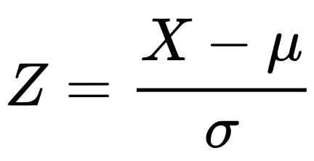
Analysis
z-score
μ = mean
σ = standard deviation
X = individual data point
CLMM
Emphasis: without β1 = -0.25, p = 0.03
Modality: written β1 = -1.99, p = 0.02
Fragment type: lexical β1 = -0.4486, p < 0.01
Cumulative Link Mixed Model

Slide 72
Analysis: hypotheses
Modality
H0: There is no significant difference between auditory and written stimuli.
H1: Auditory stimuli receive higher acceptability ratings than written stimuli.
mod.clmm = clmm(as.factor(response) ~ modality + (1|submission_id) + (1|trial_number), data = dat)summary(mod.clmm)
We judge there to be evidence in favour of the second hypothesis, if the p-value is less than 0,05.
p-value = 0.0158

Slide 73
Analysis: hypotheses
Emphasis
H0: There is no significant difference between stimuli with and without emphasis.
H1: Stimuli with emphasis receive higher acceptability ratings than stimuli without emphasis.
method:emp.clmm = clmm(as.factor(response) ~ emphasis + (1|submission_id) + (1|trial_number), data = dat)
We judge there to be evidence in favour of the first hypothesis, if the p-value is less than 0,05
p-value = 0.0268

Slide 74
Analysis: hypotheses
Fragment type
H0: There is no significant difference between stimuli with lexical and functional fragments.
H1: Stimuli with lexical fragments receive higher acceptability ratings than stimuli with functional fragments
frag.clmm = clmm(as.factor(response) ~ fragment_type + (1|submission_id) + (1|trial_number), data = dat)
We judge there to be evidence in favour of the third hypothesis, if the p-value is less than 0,05.
p-value = 9.6e-05

Slide 75
Analysis: model testing
AIC
difference: -28
Lower AIC for null model
ANOVA
p < 0.01
significantly better model fit

Slide 76
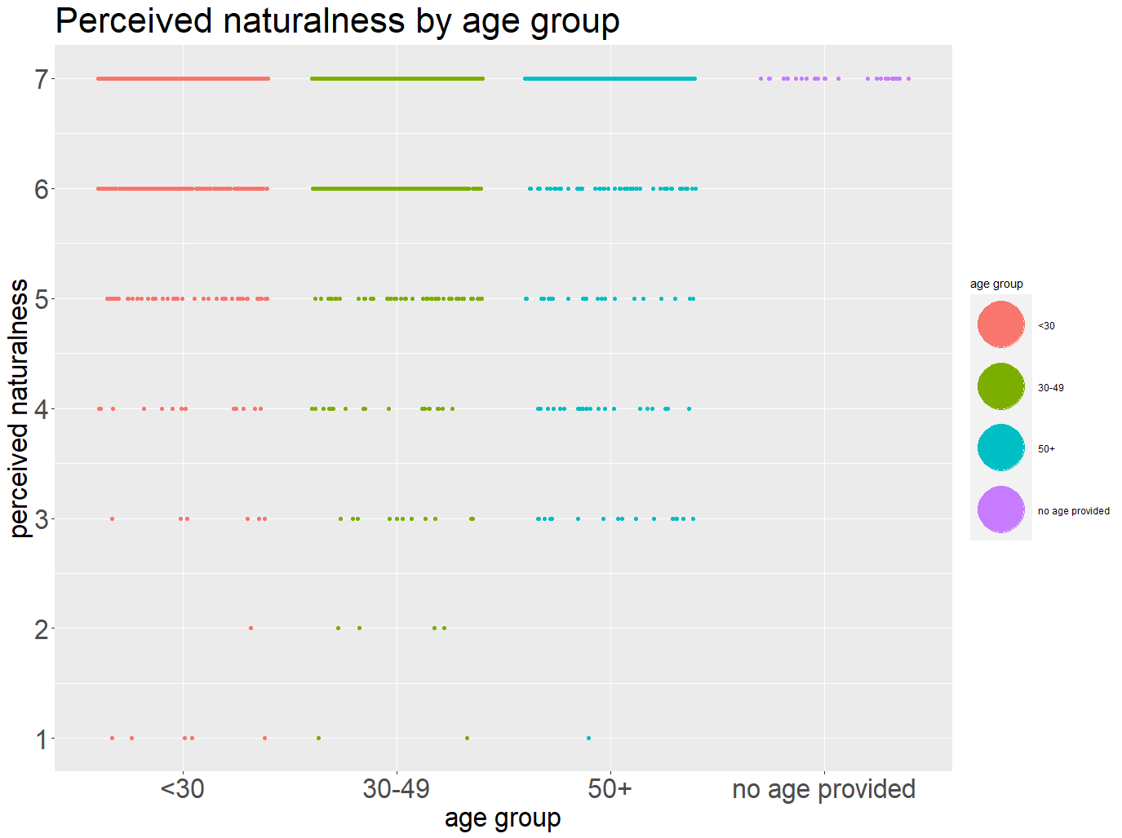
Further Results
age
<30 years: m = 6.66
30-49 years: m = 6.54
50+ years: m = 6.43

Slide 77
Further Results
age
<30 years: 42 pps
30-49 years: 41 pps
50+ years: 16 pps

Slide 78
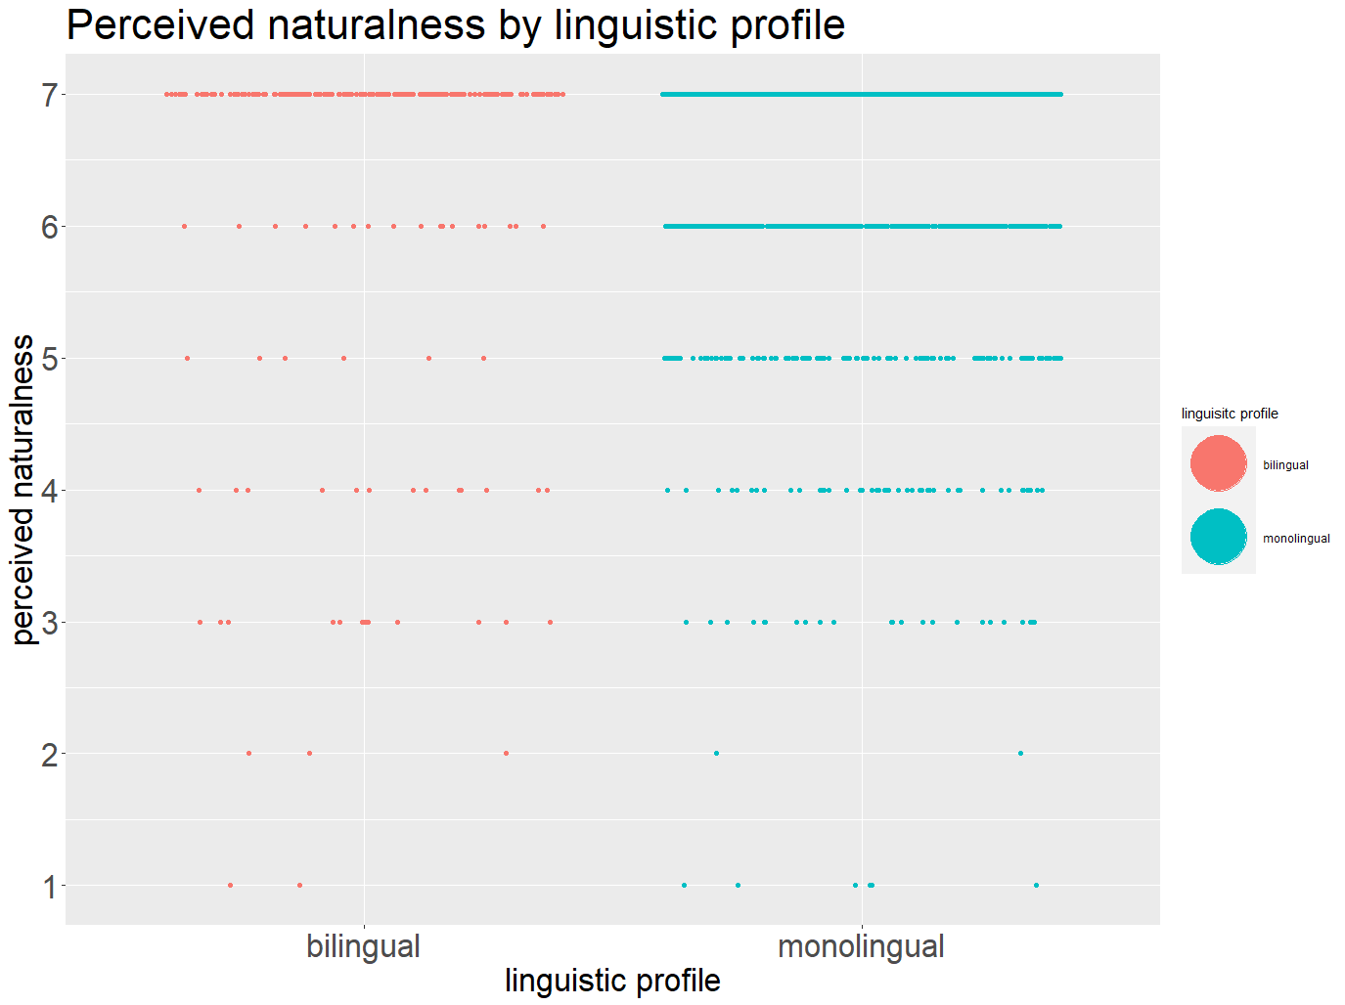
Further Results
linguistic profile
bilingual: m = 6.43, sd = 1.29
monolingual: m = 6.59, sd = 0.80

Slide 79
Further Results
linguistic profile
9 bilinguals
91 mono-linguals

